Slide 1

UT Austin
June 20 2018

Slide 2
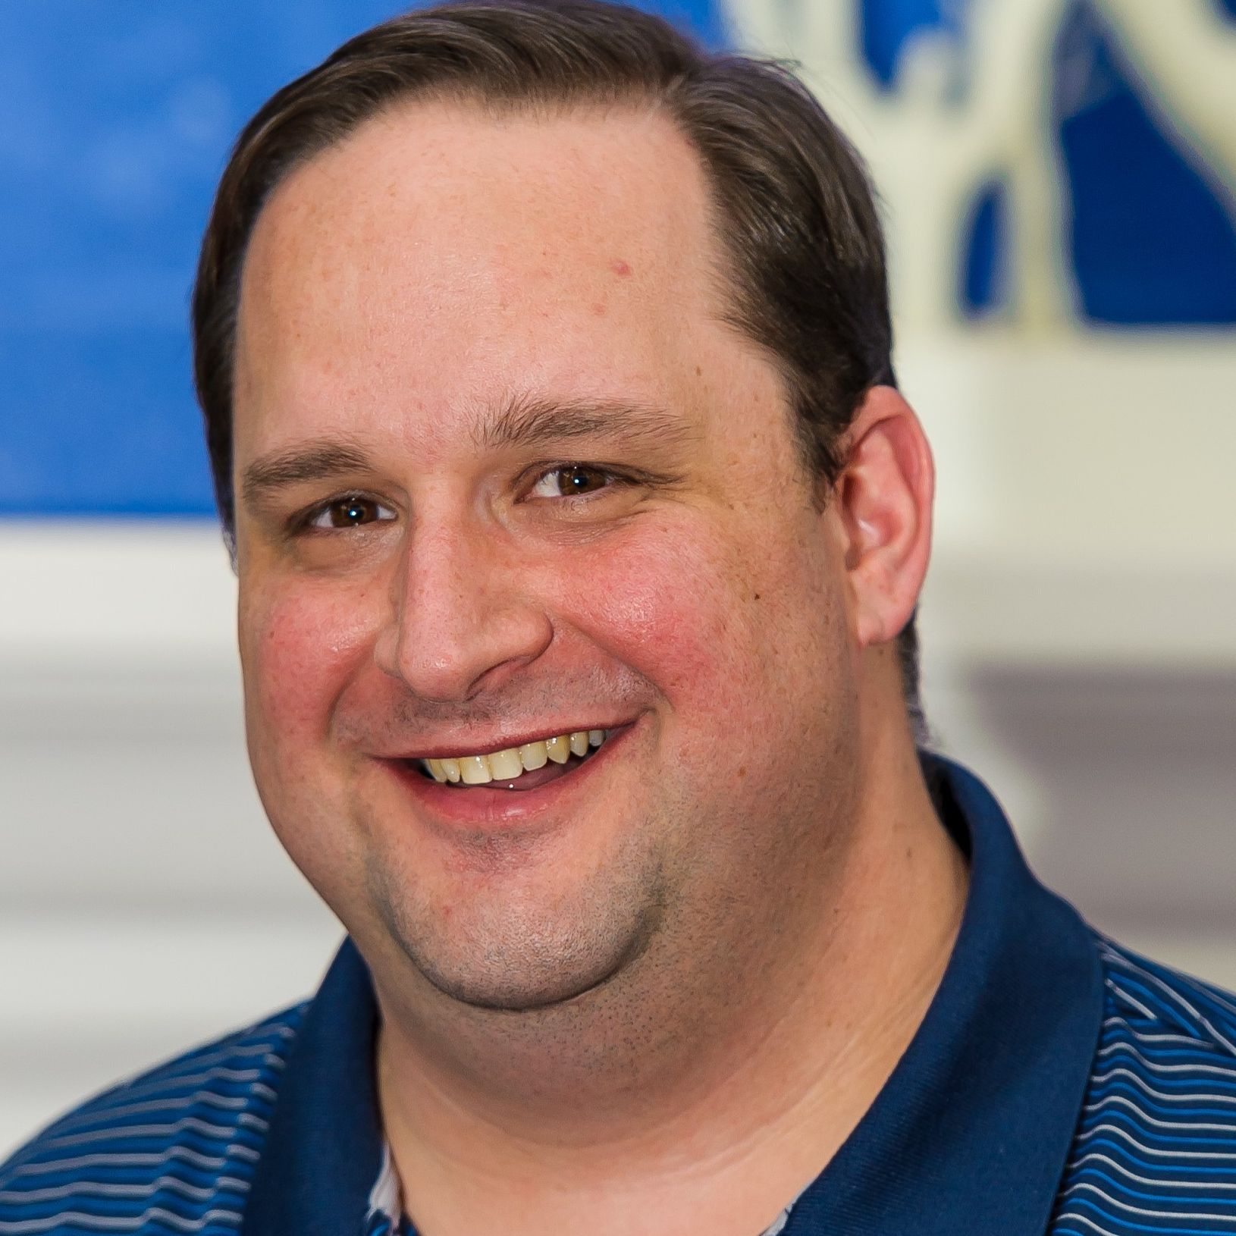
About Me
Shawn Weisfeld
Cloud Solution Architect
Microsoft – One Commercial Partner Technical Team
sweisfel@microsoft.com
Austin, TX
Download Slides @ https://aka.ms/UTA/20180620

Slide 3
My Journey

Slide 4
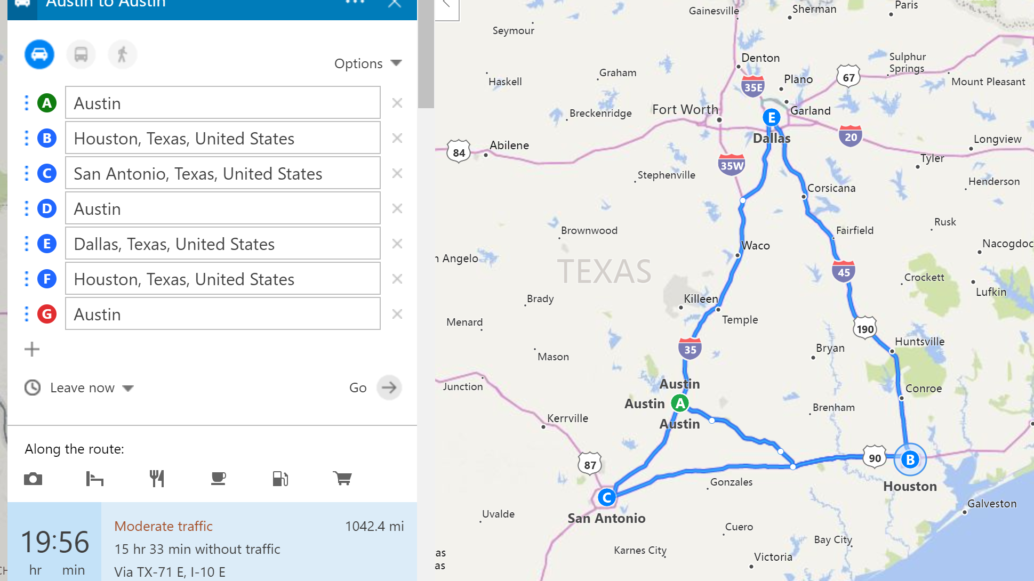
Today
This week

Slide 5

Source: http://imgkid.com/snake-game-gif.shtml

Slide 6
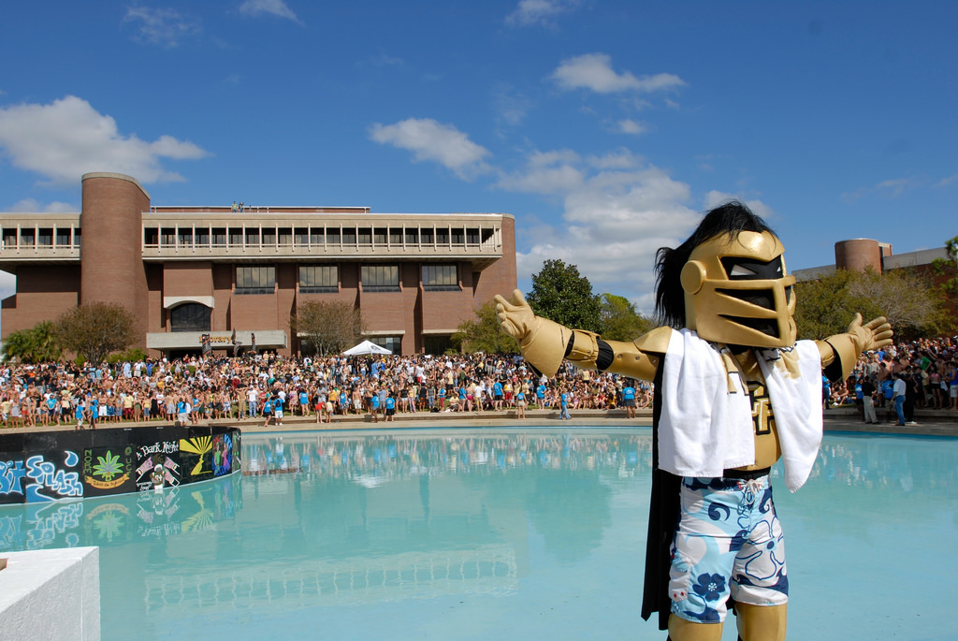

Source: https://www.flickr.com/photos/universityofcentralflorida/3402843642

Slide 7

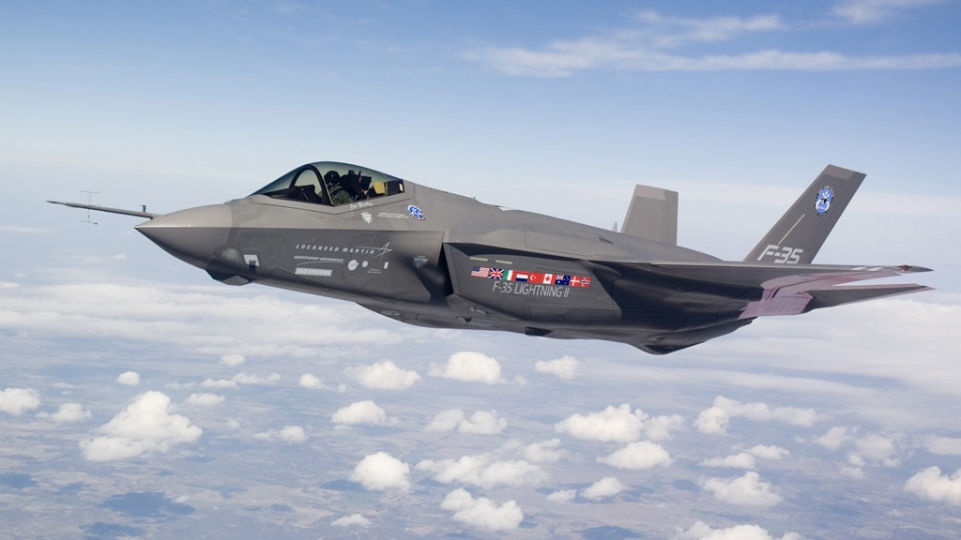
Source: http://www.military-today.com/aircraft/lockheed_martin_f35_images.htm

Slide 8
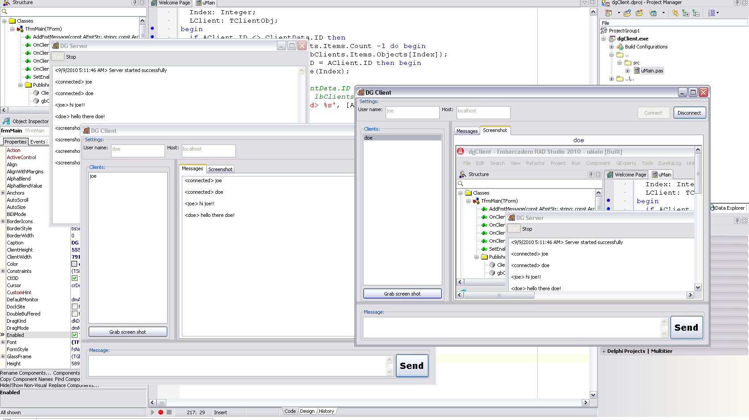
Source: http://www.delphigeist.com/2010/09/custom-client-server-application-with.html

Slide 9
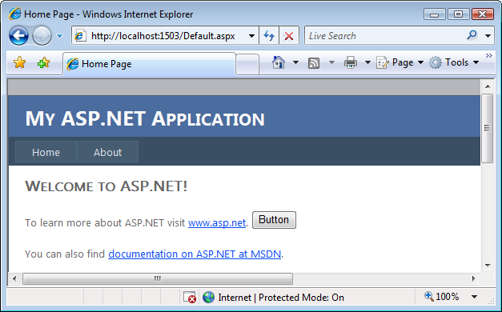
Source: http://dotnetmonitor.vlasovstudio.com/2010/07/06/monitoring-asp-net-applications/

Slide 10
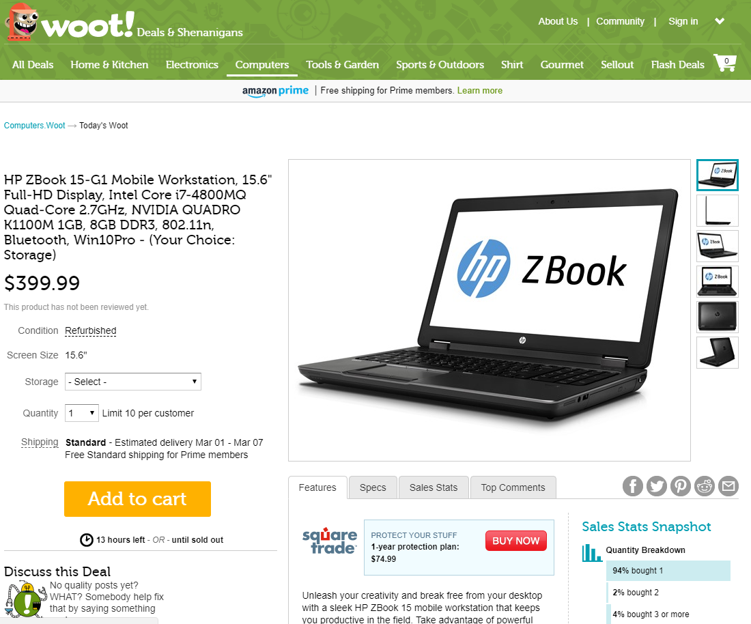

Slide 11
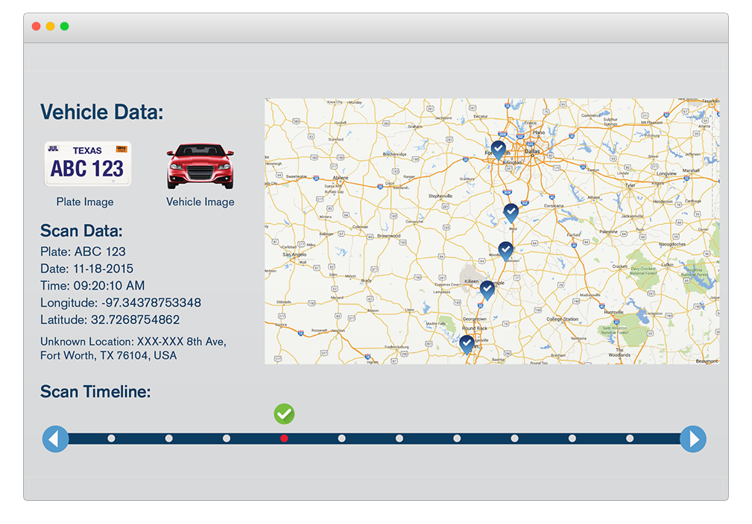
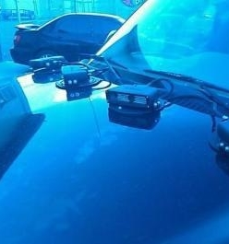

Slide 12


Slide 13

Source: http://cloud9solutions.com/?page_id=19

Slide 14

Source: http://www.passionforsavings.com/weekly-ad/dell-black-friday-ad/9/

Slide 15


Slide 16

Source: https://www.dreamstime.com/royalty-free-stock-photos-cloud-help-text-please-writing-letters-written-clouds-image36840678

Slide 17
What is the cloud?

Slide 18




Slide 19
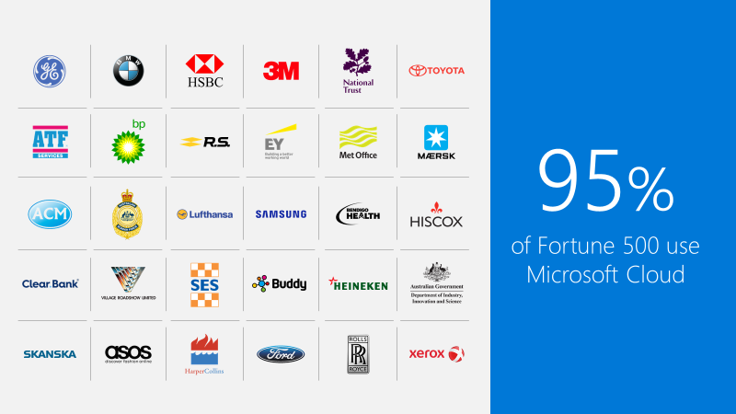

Slide 20

Source: http://colocation-expert.com/

Slide 21

Source: http://www.businessinsider.com/why-amazon-is-so-hard-to-topple-in-the-cloud-and-where-everybody-else-falls-2015-10

Slide 22
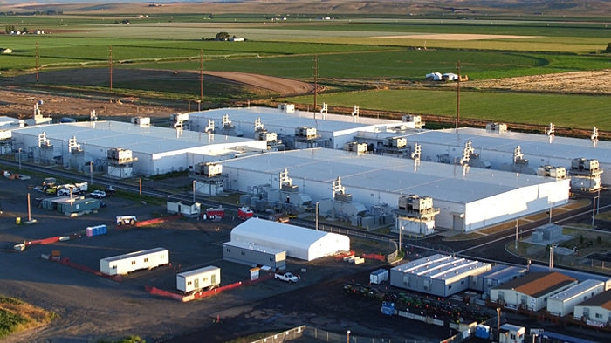
Source: http://images.techhive.com/images/article/2016/12/microsoft-data-center-100697997-large.jpg

Slide 23
Data Center Tour
Interactive
https://cloud-platform-assets.azurewebsites.net/datacenter/
Video
https://www.youtube.com/watch?v=0uRR72b_qvc

Slide 24
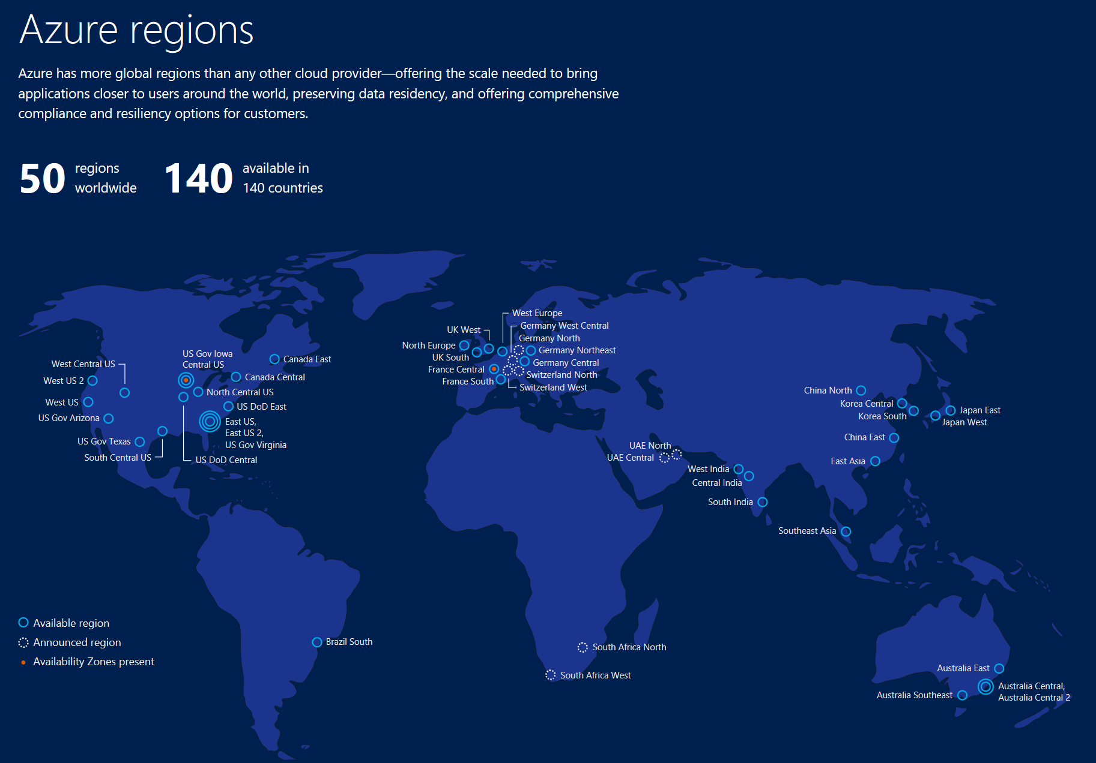

Slide 25

Characteristics
On-demand self-service
Broad network access
Resource pooling
Rapid elasticity
Measured service
Deployment Models
Private
Community
Public
Hybrid
Service Models
SaaS
PaaS
IaaS
http://nvlpubs.nist.gov/nistpubs/Legacy/SP/nistspecialpublication800-145.pdf

Slide 26
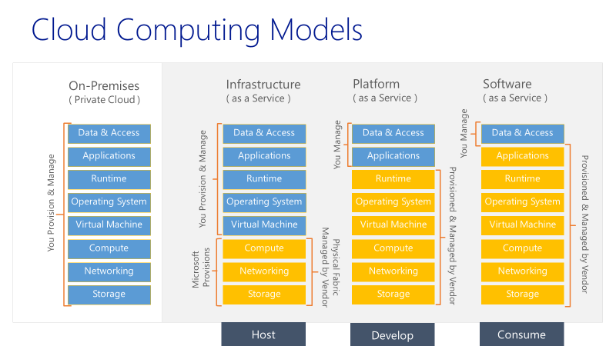

Slide 27

Microsoft Imagine
https://imagine.microsoft.com
Free Software
Build web, mobile, games, mixed reality
Free Cloud
Host a website & database
Free Training
Imagine Cup Competition
Source: http://www.cloudsprawl.net/beware-of-clouds-bearing-gifts-in-todays-iaas-competitive-landscape/

Slide 28

Source: http://adjunctassistance.com/teaching-tips-techniques/questions-teaching-tips-techniques/how-college-faculty-should-ask-their-students-questions

Slide 29

Email: sweisfel@microsoft.com
Download Slides @ https://aka.ms/UTA/20180620

